Slide 1
Biometric Template Protection
Guided by - Dr. Vireshwar Kumar (IIT Delhi)

Slide 2
Flow Of Code
Initialization
Dataset Preparation
Image Preprocessing
Fine-tuning the VGG16 Model
Training the model
Feature Extraction and Computing Similarity Scores
Biometric Evaluation

Slide 3
Dataset
Preparation
Initially had 9 images for 200 subjects
Performed train-test split and used 4 images for training and 5 for testing per subject
Performed data-augmentation on training images generating 99 extra images per train sample having different features
Total Train images = 800 * 1000 = 80000
Total Test images = 1000

Slide 4
Image Pre-Processing
Resizing the image into 224x224 dimensions
Converting the image into RGB format
Normalize the pixel values in the range 0 to 1
Subtract the channel-wise mean pixel values over the dataset
Expanding the dimensions of the input image array to 4D
Converting the image array into appropriate data type

Slide 5
Fine-tuning the VGG16 Model
Using the first 15 layers of the pretrained VGG16 architecture. The weights of the first 15 layers are freezed.
16th Layer – Fully Connected Layer with 2048 Neurons [Activation Function: ReLu]
17th Layer – Fully Connected Layer with 1024 Neurons [Activation Function: ReLu]
18th Layer – Fully Connected Layer with 512 Neurons [Activation Function: ReLu]
19th Layer – Fully Connected Layer with 200 Neurons [Activation Function: ReLu]

Slide 6
Model: "model_1"
_________________________________________________________________
Layer (type) Output Shape Param #
=============================================================
input_1 (InputLayer) [(None, 224, 224, 3)] 0
block1_conv1 (Conv2D) (None, 224, 224, 64) 1792
block1_conv2 (Conv2D) (None, 224, 224, 64) 36928
block1_pool (MaxPooling2D) (None, 112, 112, 64) 0
block2_conv1 (Conv2D) (None, 112, 112, 128) 73856
block2_conv2 (Conv2D) (None, 112, 112, 128) 147584
block2_pool (MaxPooling2D) (None, 56, 56, 128) 0
block3_conv1 (Conv2D) (None, 56, 56, 256) 295168
block3_conv2 (Conv2D) (None, 56, 56, 256) 590080
block3_conv3 (Conv2D) (None, 56, 56, 256) 590080
block3_pool (MaxPooling2D) (None, 28, 28, 256) 0
block4_conv1 (Conv2D) (None, 28, 28, 512) 1180160
block4_conv2 (Conv2D) (None, 28, 28, 512) 2359808
block4_conv3 (Conv2D) (None, 28, 28, 512) 2359808
block4_pool (MaxPooling2D) (None, 14, 14, 512) 0
block5_conv1 (Conv2D) (None, 14, 14, 512) 2359808
block5_conv2 (Conv2D) (None, 14, 14, 512) 2359808
block5_conv3 (Conv2D) (None, 14, 14, 512) 2359808
block5_pool (MaxPooling2D) (None, 7, 7, 512) 0
flatten (Flatten) (None, 25088) 0
fc6 (Dense) (None, 4096) 102764544
fc7 (Dense) (None, 4096) 16781312
fc8 (Dense) (None, 2048) 8390656
fc9 (Dense) (None, 1024) 2098176
fc10 (Dense) (None, 512) 524800
fc11 (Dense) (None, 200) 102600
==================================================
Total params: 145,376,776
Trainable params: 11,116,232
Non-trainable params: 134,260,544
_____________________________________________________

Slide 7
Feature Extraction and Computing Similarity Score
Extract the 4096 dimensional feature vector and store them
For calculation of similarity scores, compute all the genuine as well as imposter pairs
Genuine pairs = 200 * (9C2) = 7200
Imposter pairs = [9 * {(200-1)* 9} * 200] / 2 = 1611900
Compute the similarity scores for every genuine and imposter pair
For every value of threshold from interval [0.0, 1.0], compute the number of scores above the threshold value and calculate the FAR, DRR and GAR values for each value of threshold.

Slide 8
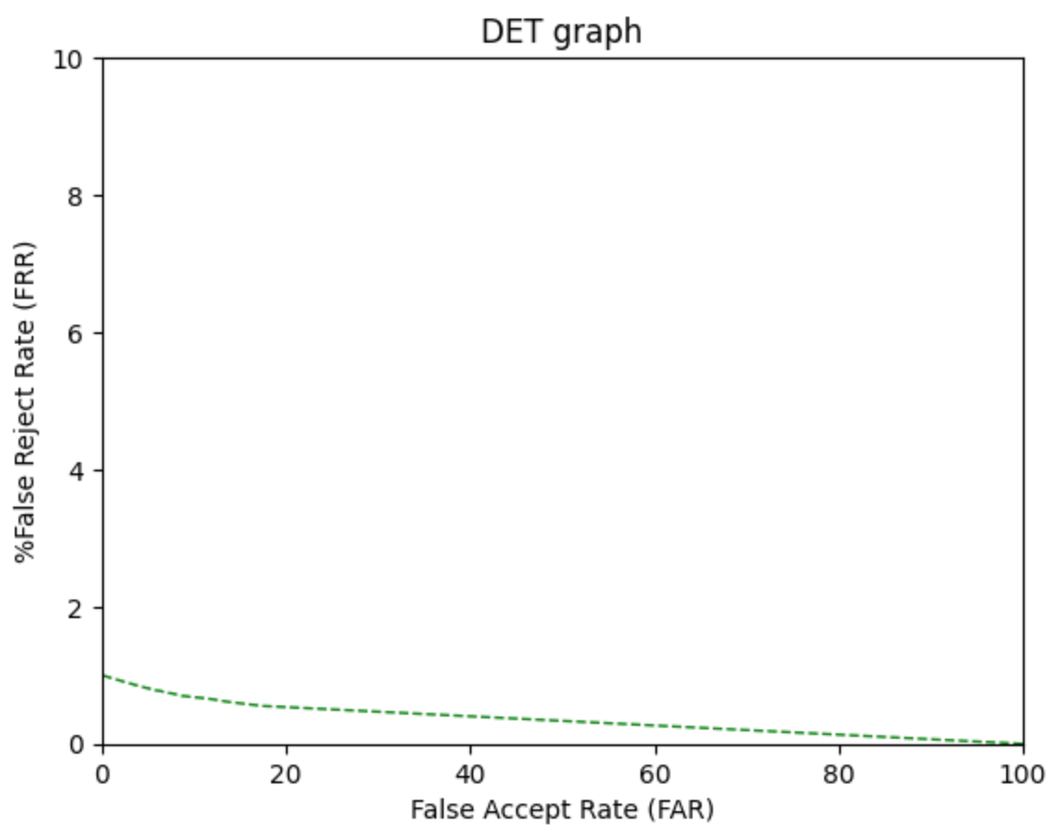
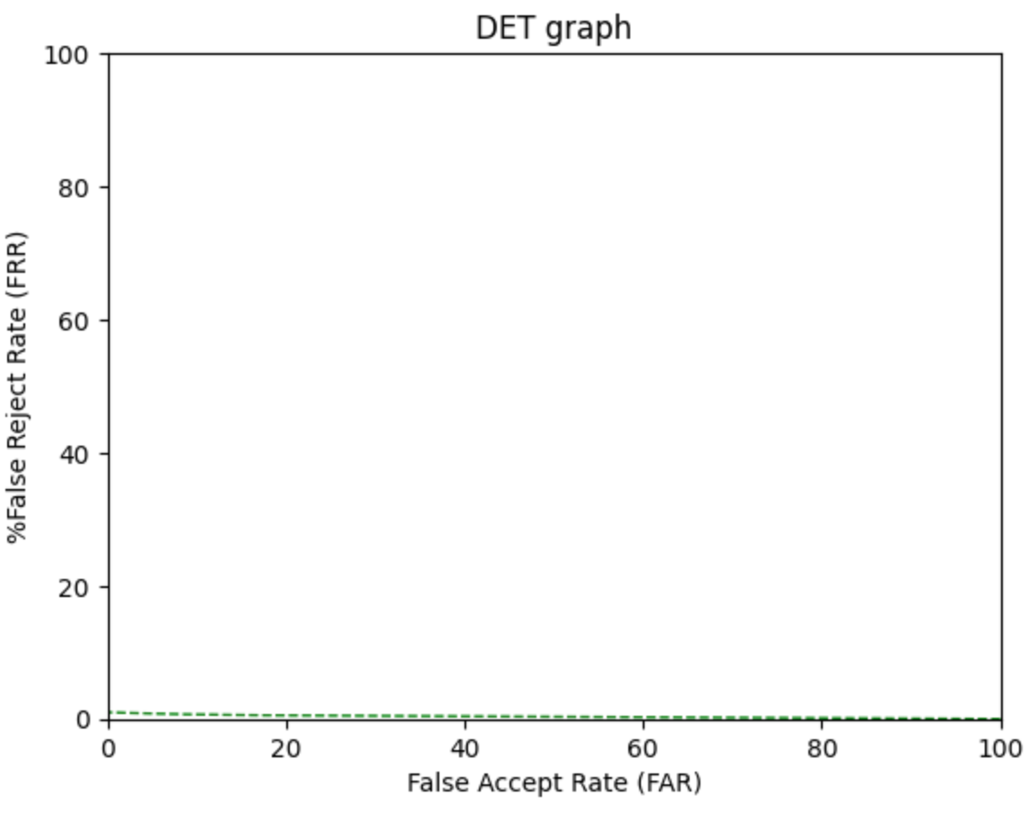
Biometric Evaluation
DET Graph

Slide 9
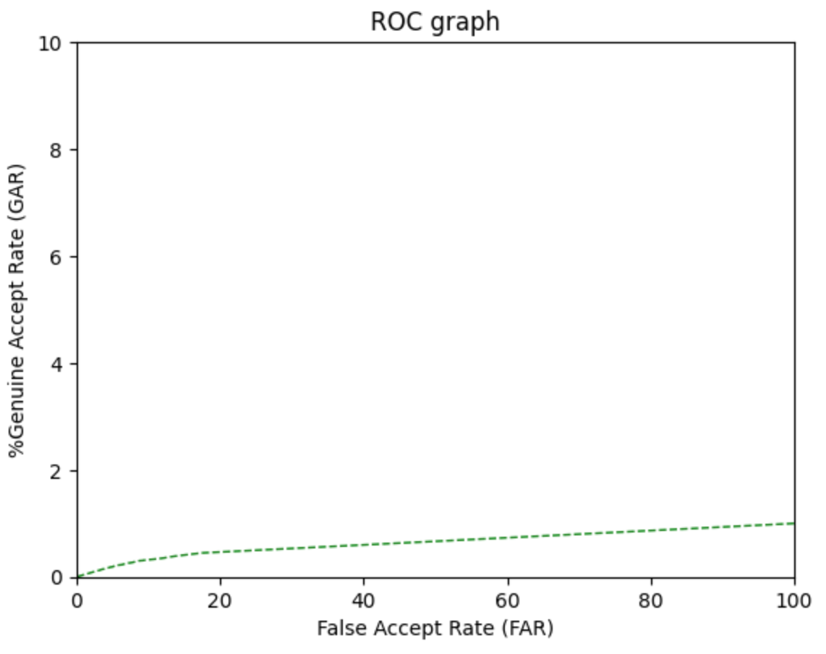
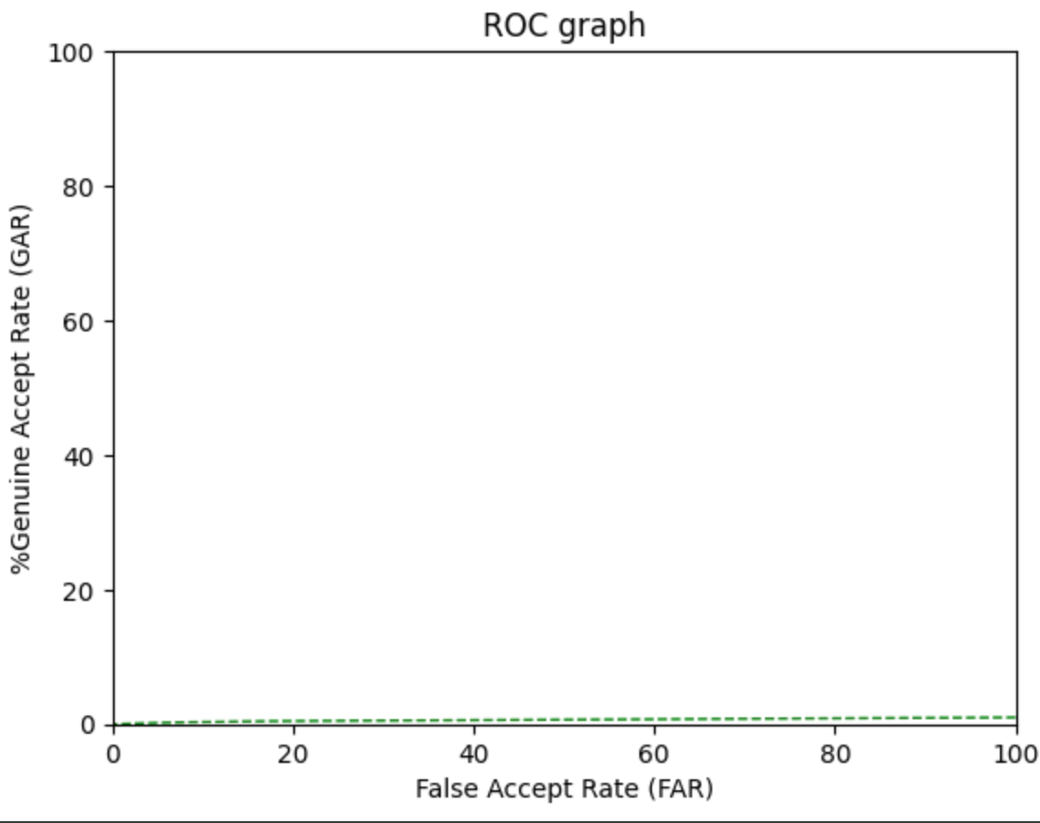
Biometric Evaluation
ROC Graph

Slide 10
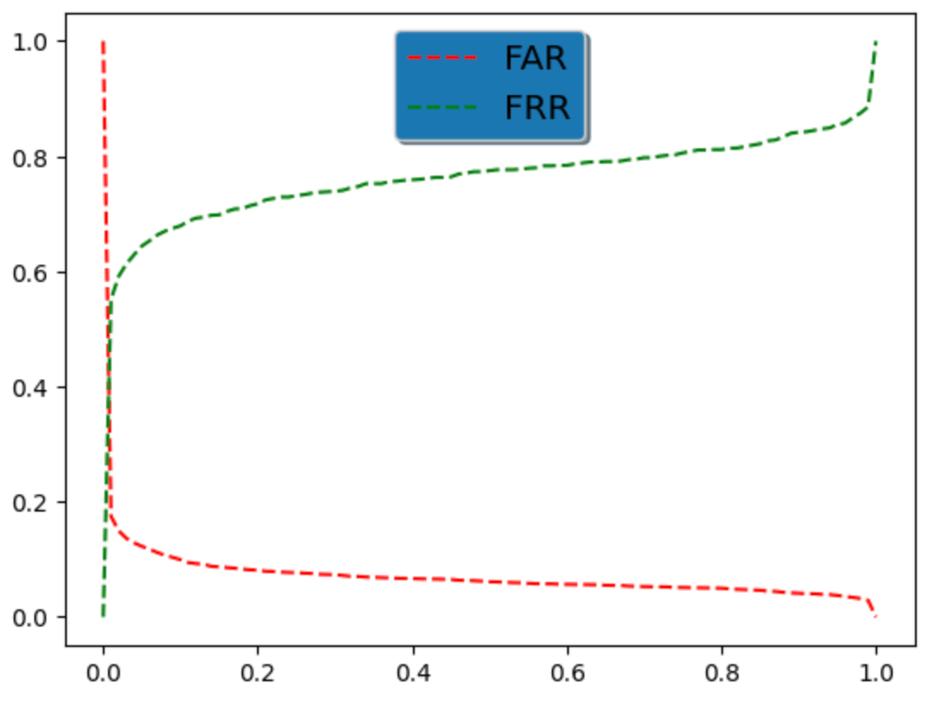
Biometric Evaluation
Equal Error Rate

Slide 11
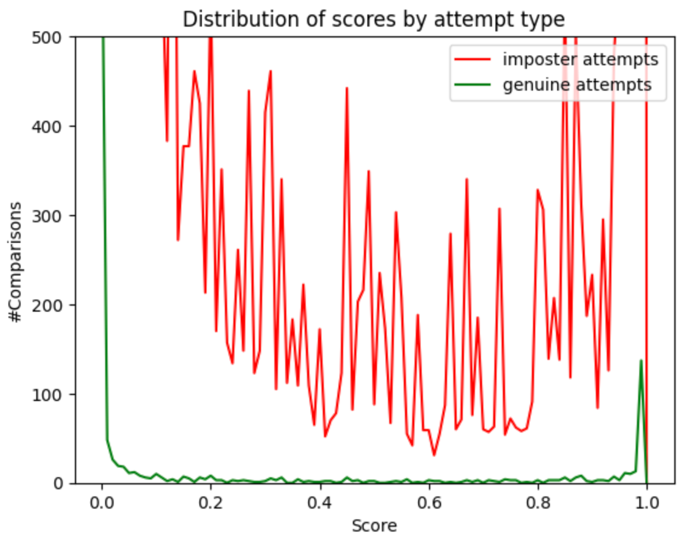
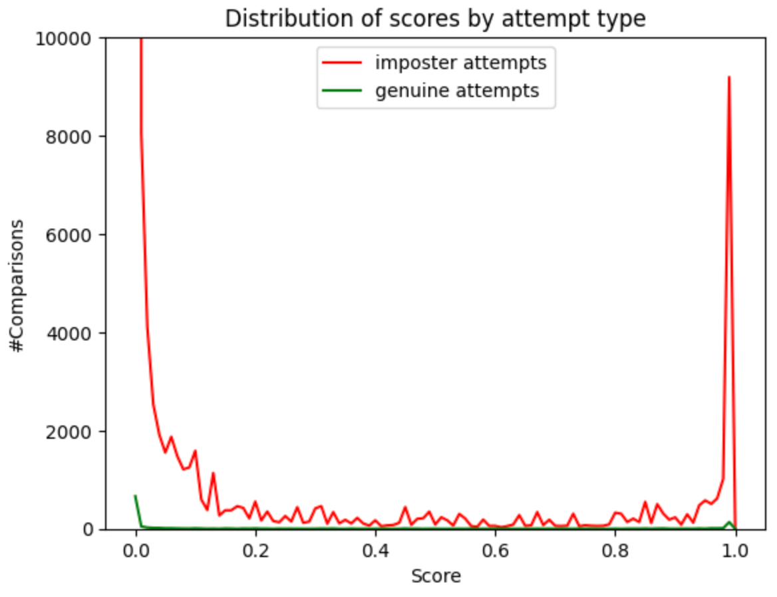
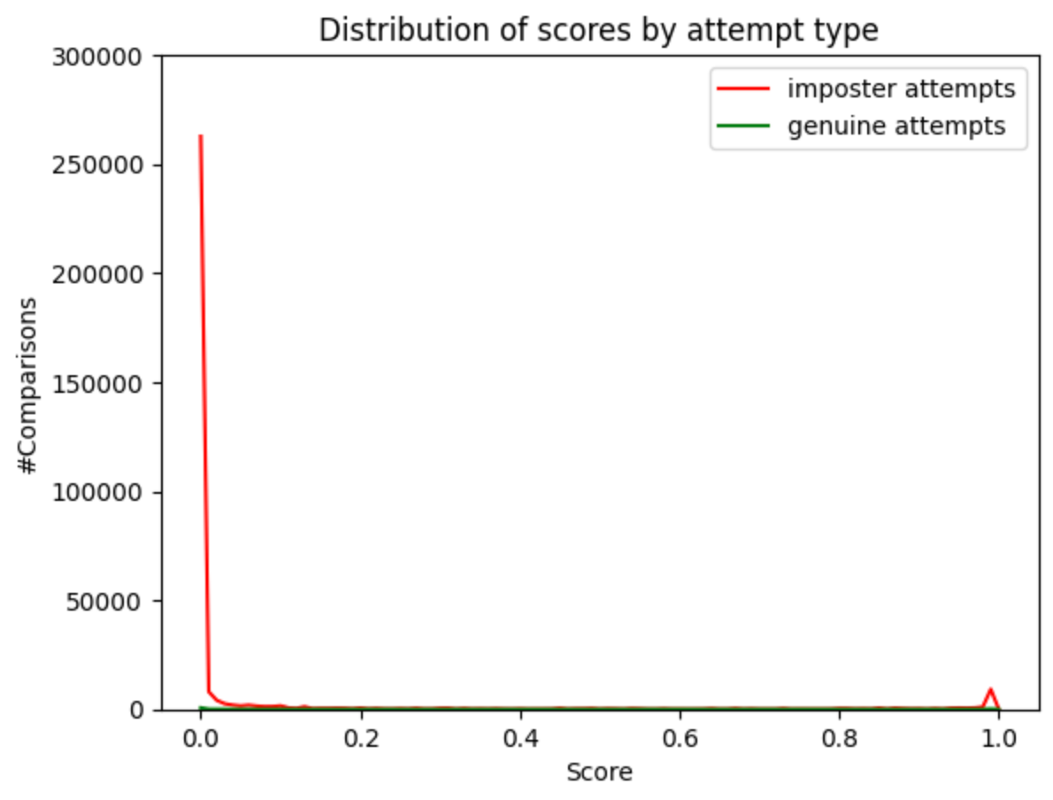
Biometric Evaluation
Distribution of scores by attempt type

